Slide 1
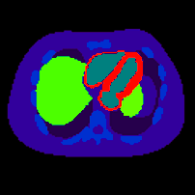
NCAT 4D Phantom example in GATEv6.2
Han Gyu Kang
Imaging Physics Group
2020.02.07.Friday
Activity map
Attenuation map
hangyookang@gmail.com
Kang.hangyu@qst.go.jp

Slide 2
Outline
NCAT 4D phantom example in GATEv6.2
How to use NCAT 4D Phantom in GATEv6.2
Attenuation phantom (CT image)
Activity source (PET image)

Slide 3
NCAT 4D phantom example in GATEv6.2

Slide 4
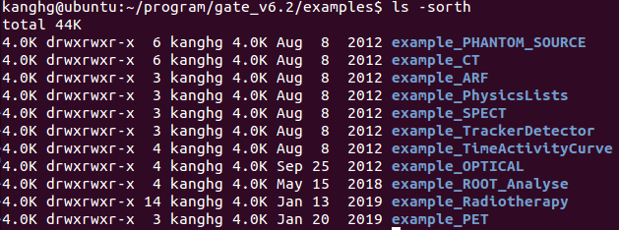
NCAT 4D phantom example files in GATEv6.2
>cd example_TimeActivityCurve
>cd data
NCAT Phantom files (atn, act)

Slide 5
NCAT 4D phantom example files in vGATEv8.2
>cd GateContrib/imaging/TimeActivityCurve/data
NCAT Phantom files (atn, act)

Slide 6
NCAT Phantom
McGurk et al., 2010 PMB

Slide 7
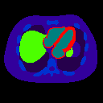
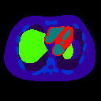
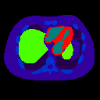
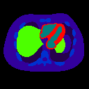
NCAT 4D Phantom (Activity map) GIF animation
#10
#9
Activity map (PET)
#8
#7
#6
#5
#4
#3
#2
Act#1
0.1 s/frame

Slide 8
NCAT 4D Phantom (Attenuation map) GIF animation
#10
#9
Attenuation map (CT)
#8
#7
#6
#5
#4
#3
#2
Atn#1
0.1 s/frame

Slide 9
Activity map (PET) vs. Attenuation map (CT)
Animation!
Real-time motion simulation using NCAT phantom
Activity map (PET)
Attenuation map (CT)
Act + Atn fusion
0.1 s/frame
You can define the Time Activity Curve(TAC) to specific voxel values

Slide 10
Description of NCAT 4D Phantom

Slide 11
NCAT 4D Phantom simulation: 8 steps
1 – Verbosity and Visualization
2 – Define the NCAT 4D Phantom geometry
3 – Physics processes
4 – Initialization the simulation : Compute cross-section tables for particles,
1,2,3 could not be changed AFTER the “Initialization”
5 – Source (NCAT voxelized source : Time Activity Curve)
6 – Digitizer(PET)
7 – Output setup (ROOT, RawSinogram, ECAT7 output setting)
8 – Start the simulation
Attenuation phantom (CT image)
Activity source (PET image)

Slide 12
GATE6.2 NCAT 4D Phantom macro files
NCAT_4D_Phantom_TimeActivityCurve_GATEv6p2_KangHG
Voxelized PET activity source
Voxelized CT attenuation phantom
Materials information (Water, PMMA, Lung, and so on)
OpenGL viewer setting
Main Macro
Verbosity output level setup
PET ECAT7 system
NCAT 4D Phantom
Voxelized PET activity source
Voxelized CT attenuation phantom
Physics list
Output setup

Slide 13
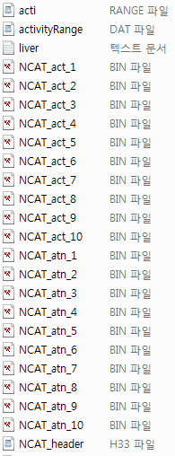
“data” folder contents (1)
PET activityRange translator
PET image(binary)
CT image (binary)
CT image (header)
CT voxel value ->Material
(rangeTranslator )

Slide 14
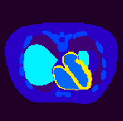
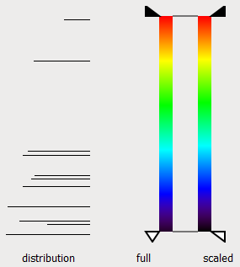
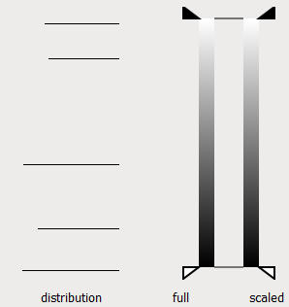
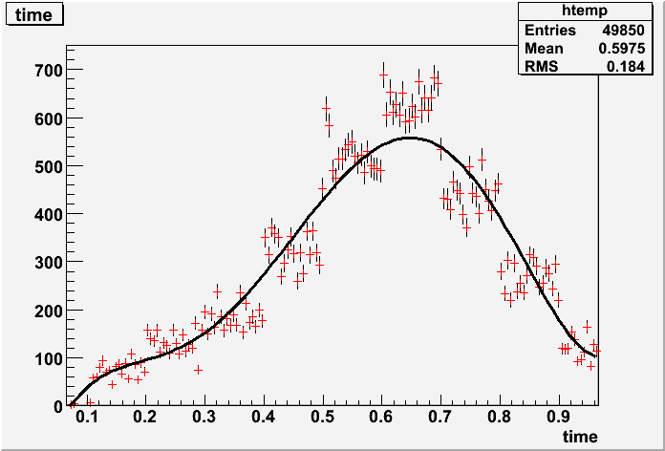
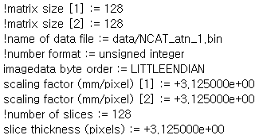
“data” folder contents (2)
Main_RTVPhantom_NCAT4D_PET_ECAT7_KangHG.mac
Voxelized-source
Voxelized-phantom
/gate/source/voxel/interfileReader/rangeTranslator/readTable
/gate/source/voxel/interfileReader/SetTimeActivityTablesFrom
TAC table
TAC table file
#of Time
bins
Myocardial blood pool
(activity)
CT image
(attenuation)
TAC
Time [sec]
Activity [Bq]

Slide 15
range.dat (CT image->Material)
36
29
15
6
0
Air
Lung
Breast
RibBone
0
6
15
29
36
Counts/bin
Pixel intensity

Slide 16
NCAT 4D Phantom (Attenuation phantom: CT image)

Slide 17
2. Attenuation phantom (CT image)
Main_RTVPhantom_NCAT4D_PET_ECAT7_KangHG.mac
#=========================
# Voxellized phantom (Ncat)
#=========================
/gate/world/daughters/name Ncat
/gate/world/daughters/insert regularMatrix
#/gate/world/daughters/insert compressedMatrix
/gate/Ncat/geometry/insertReader interfile
/gate/Ncat/verbose 0
/gate/RTPhantom/insert RTVPhantom
/gate/RTVPhantom/AttachTo Ncat
/gate/RTVPhantom/SetNumberOfFrames 10
/gate/RTVPhantom/SetTimePerFrame 0.1 s
/gate/RTVPhantom/verbose 0
/gate/RTVPhantom/setHeaderFileName data/NCAT_header.h33
/gate/Ncat/interfileReader/insertTranslator range
/gate/Ncat/interfileReader/rangeTranslator/readTable data/range.dat
/gate/Ncat/interfileReader/rangeTranslator/describe 1
# Ncat was moved -40 mm along the z-dir to locate at the center of the PET FOV (2015.05.28.KangHG)
/gate/Ncat/placement/setTranslation 0. 0. -40. mm
/gate/RTVPhantom/setBaseFileName data/NCAT
#/gate/Ncat/vis/forceSolid
#/gate/Ncat/vis/setColor Blue
/gate/Ncat/attachVoxelPhantomSD
#/gate/geometry/update
World’s daughter volume Ncat (“Ncat” is keyword)
Use “Regular Navigation” (Saving simulation time)
Search only for the neighbors of the voxel for the next transportation of the gamma photon
Interfile Reader
“RTVPhantom” is a keyword
Attach Ncat to RTVPhantom
Set the total frame of RTVPhantom (=Ncat)
Set the frame rate as 0.1 s/frame
Read the Interfile header for Ncat
CT image range -> Material
Read the range.dat file
Translate the Ncat -40 mm in Z-direction (Axial)
NCAT interfile을 data폴더의 NCAT으로 시작하는 파일명으로 지정
Attach the PhantomSensitiveDetector to Ncat volume

Slide 18
NCAT 4D Phantom (Activity source: PET image)

Slide 19
5. Activity Source (PET image)
Main_RTVPhantom_NCAT4D_PET_ECAT7_KangHG.mac
#=====================================
# Cubic voxelized-source (PET image)
#=====================================
/gate/source/addSource voxel voxel
/gate/source/verbose 0
/gate/source/voxel/reader/insert interfile
/gate/RTVPhantom/AttachToSource voxel
/gate/source/voxel/interfileReader/translator/insert range
/gate/source/voxel/interfileReader/rangeTranslator/readTable data/activityRange.dat
/gate/source/voxel/interfileReader/SetTimeActivityTablesFrom data/acti.range
/gate/source/voxel/interfileReader/SetTimeSampling 0.1 s
/gate/source/voxel/interfileReader/rangeTranslator/describe 1
# 4D phantom was moved -40 mm along the z-dir.
/gate/source/voxel/setPosition -200. -200. -240. mm
/gate/source/voxel/setType backtoback
/gate/source/voxel/gps/particle gamma
/gate/source/voxel/setForcedUnstableFlag true
/gate/source/voxel/setForcedHalfLife 6586.2 s
/gate/source/voxel/gps/energytype Mono
/gate/source/voxel/gps/monoenergy 0.511 MeV
/gate/source/voxel/gps/confine NULL
/gate/source/voxel/gps/angtype iso
/gate/source/voxel/dump 0
/gate/source/voxel/verbose 0
Create a source named voxel
Attach the “RTVPhantom” to “voxel” source
Insert rangeTranslator to voxel source
rangeTranslator
Read the TAC table
Set the frame rate as 0.1 s/frame
Translation of the Voxel source in x,y,z directions
backtoback source
Particle type= gamma
Half-life = 6686.2 s (F-18)
511 keV mono energy gamma photon
gamma source is not confined to other volumes
Isotropic gamma emission

